Slide 1
Merry Christmas Taiwan
Team 2
Jessie, Glue, and Jay

Slide 2
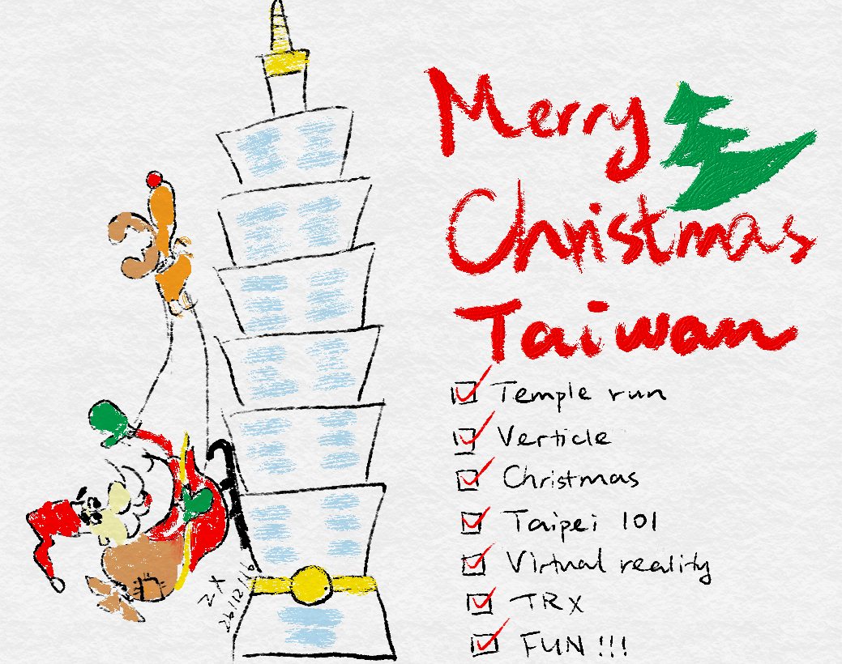

Slide 3
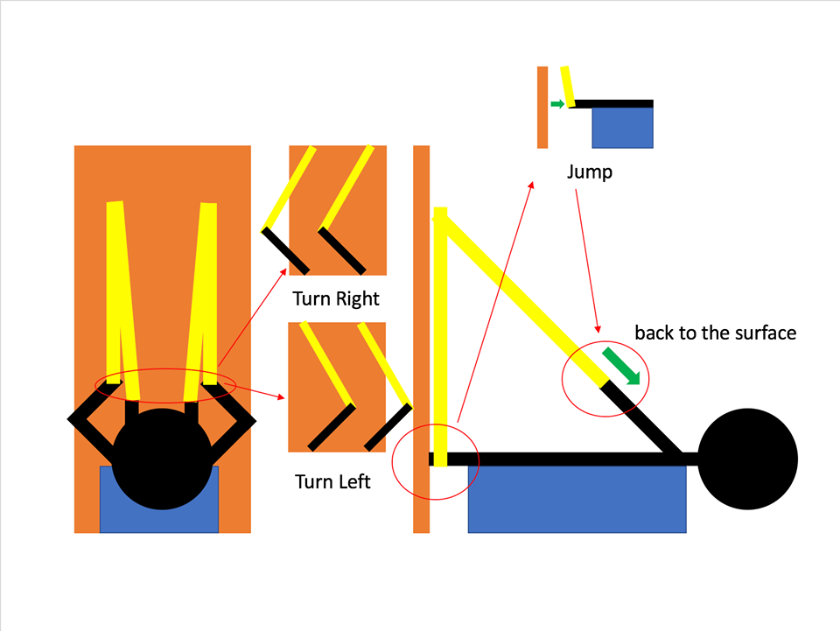

Slide 4










